Slide 1
Dynamic Programming

Slide 2
Dynamic Programming – The IDEA
A technique for solving problems with overlapping sub – problems.
These sub – problems arise from a recurrence relating a solution to a given problem with solutions to its smaller sub - problems of the same type.
Ex: Fibonacci Number Sequence

Slide 3
Dynamic Programming – The IDEA
Dynamic Programming suggests:
Solve each of these sub – problems only once
Store the results in a table
Use these results to obtain solutions to the original problem.

Slide 4
Dynamic Programming – An EXAMPLE
FIBONACCI NUMBERS
0, 1, 1, 2, 3, 5, 8, 13, 21, 34, …..
Recurrence Relation:
F(n) = F(n-1) + F(n-2) for n >= 2
F(0) = 0, F(1) = 1

Slide 5
Dynamic Programming – An EXAMPLE
If the recurrence is directly used to compute the n^{th} Fibonacci number, we would have to recompute the same values again and again.
Ex: F(6) = F(5) + F(4)
F(5) = F(4) + F(3)
F(4) = F(3) + F(2) ……

Slide 6
Dynamic Programming – An EXAMPLE
Instead, we can simply fill elements of a one – dimensional array with the n + 1 consecutive values of F(n) by starting with the initial elements and using the equation to produce all other elements.

Slide 7
Computing a Binomial Co - Efficient
1

Slide 8
What is Binomial Co – Efficient?
Binomial Co - efficient, denoted C(n, k) is the number of combinations (subsets) of k elements from an n-element set (0 <= k <= n).
The name comes from the participation of these numbers in the binomial formula:
(a+ b)^{n}= C(n, O)a^{n} +. . . + C(n, k)a^{n-k}b^{k} + · · · + C(n, n)b^{n}.

Slide 9
Binomial Co – Efficient
Properties:
C(n, k) = C(n- 1, k- 1) + C(n- 1, k) for n > k > 0
C(n, 0) = C(n, n) = 1
The nature of the recurrence is such that it can be solved by Dynamic Programming.

Slide 10
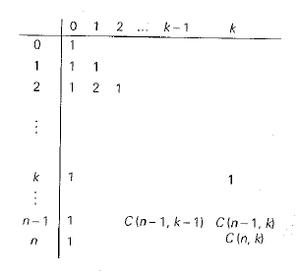
Binomial Co – Efficient
To do this, we record the values of the binomial coefficients in a table of n + 1 rows and k + 1 columns, numbered from 0 to n and from 0 to k, respectively

Slide 11
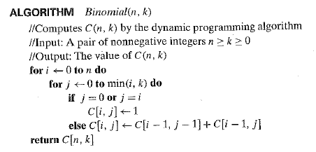
Binomial Co – Efficient – The ALGORITHM

Slide 12
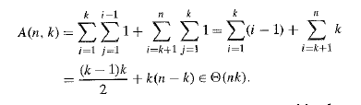
Binomial Co – Efficient – The EFFICIENCY

Slide 13
Warshall’s Algorithm
2

Slide 14
What is Transitive Closure?
The transitive closure of a directed graph with n vertices can be defined as the n-by-n boolean matrix T = {t_{i,j}}, in which the element in the i^{th} row (1 <= i<= n) and the j^{th} column (1 <= j <= n) is 1 if there exists a nontrivial directed path (i.e., a directed path of a positive length) from the i^{th} vertex to the j^{th} vertex; otherwise, t_{ij} is 0.

Slide 15
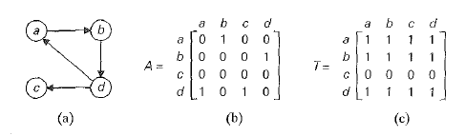
What is Transitive Closure?
Directed Graph
Adjacency Matrix
Transitive Closure

Slide 16
Warshall’s Algorithm – The IDEA
Warshall’s Algorithm constructs the transitive closure of a digraph with n vertices through a series of n – by – n Boolean matrices.
R⁽⁰⁾, R⁽¹⁾, . . ., R^{(k-1)}, R^{(k)}, . . ., R^{(n)}
The element r_{ij}^{(k)} in the i^{th} row and j^{th} column of matrix R^{(k)} (k = 0, 1, ... , n) is equal to 1 if and only if there exists a directed path (of a positive length) from the i^{th} vertex to the j^{th} vertex with each intermediate vertex, if any, numbered not higher than k.

Slide 17
Warshall’s Algorithm – The IDEA
Rules for generating elements of matrix R^{(k)} from R^{(k-1)}:
If an element r_{ij} is 1 in R^{(k-1)}, it remains so in R^{(k)}.
If an element r_{ij} is 0 in R^{(k-1)}, it can be changed to 1 in R^{(k)} if and only if the element in its row i and column k and the element in row k and column j are both 1’s in R^{(k-1)}.

Slide 18
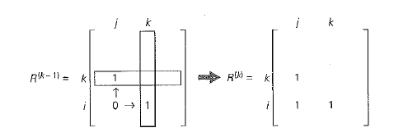
Warshall’s Algorithm – The IDEA

Slide 19
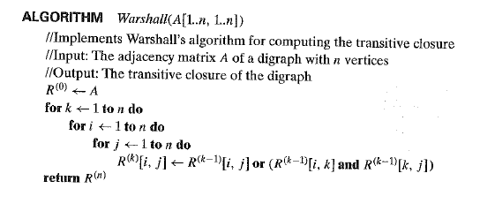
Warshall’s Algorithm

Slide 20
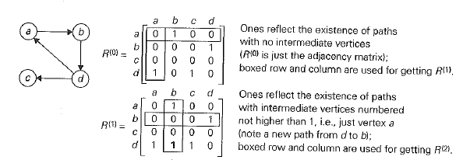
Warshall’s Algorithm – An EXAMPLE

Slide 21
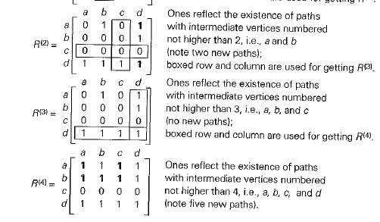
Warshall’s Algorithm – An EXAMPLE

Slide 22
Warshall’s Algorithm
Efficiency: Θ (n³)

Slide 23
Floyd’s Algorithm for All Pairs Shortest Path
3

Slide 24
All Pairs Shortest Path
The all-pairs shortest paths problem asks to find the distances (the lengths of the shortest paths) from each vertex to all other vertices.
It is convenient to record the lengths of shortest paths in an n-by-n matrix D called the distance matrix: the element d_{ij} in the i^{th} row and the j^{th} column of this matrix indicates the length of the shortest path from the i^{th} vertex to the j^{th} vertex (1 <= i, j <= n ).

Slide 25
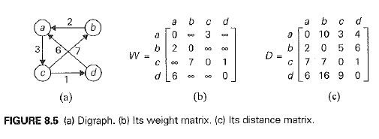
All pairs shortest path

Slide 26
Floyd’s Algorithm – The IDEA
Floyd’s Algorithm computes the distance matrix of a weighted graph with n vertices through a series of n – by – n matrices:
D(0), D(1), . . . , D(k-1), D(k), . . . , D(n)
The element d_{ij}^{(k)} in the i^{th} row and j^{th} column of matrix D^{(k)} is equal to the length of the shortest path among all paths from the i^{th} vertex to the j^{th} vertex with each intermediate vertex, if any, numbered not higher than k.

Slide 27
Floyd’s Algorithm – The IDEA
d_{ij}^{(k)} is equal to the length of the shortest path among all paths from i^{th} vertex v_{i} to j^{th} vertex v_{j} with their intermediate vertices not numbered higher than k.
All such paths can be partitioned into two disjoint subsets: ones which do not use vk as the intermediate vertex and which do.

Slide 28
Floyd’s Algorithm – The IDEA
Taking into account both these subsets lead to the following recurrence:

Slide 29
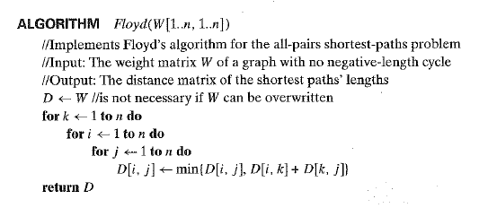
Floyd’s Algorithm

Slide 30
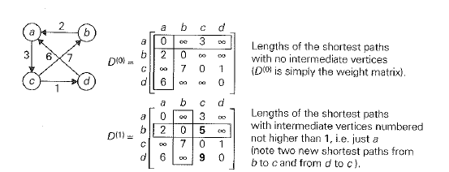
Floyd’s Algorithm – An EXAMPLE

Slide 31
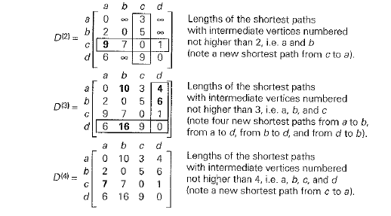
Floyd’s Algorithm – An EXAMPLE

Slide 32
Floyd’s Algorithm
Efficiency: Θ (n³)

Slide 33
Knapsack Problem and Memory Functions
4

Slide 34
Knapsack Problem
Given ‘n’ items of known weights w₁, w₂, w₃, . . . , w_{n}, and values v₁, v₂, v₃, . . . , v_{n} and a knapsack of capacity W, find the most valuable subset of items that fit into the knapsack.
We have already solved this problem using Exhaustive Search.
Now, we shall see how to solve the same problem using Dynamic Programming.

Slide 35
Knapsack Problem
Let us consider an instance defined by the first I items 1 <= i <= n, with weights w₁, w₂, w₃, . . . , w_{i}, and values v₁, v₂, v₃, . . . , v_{i} and a knapsack of capacity j, 1 <= j <= W.
Let V[i, j] be the value of an optimal solution to this instance.
We can divide all the subsets of the first i items that fit into knapsack of capacity j into two categories: those that do not include the i^{th} item and those that do.

Slide 36
Knapsack Problem
Among the subsets that do not include the i^{th} item, the value of an optimal subset is, by definition, V[i - 1, j].
Among the subsets that do include the i^{th} item (hence, j - w_{i} >= 0), an optimal subset is made up of this item and an optimal subset of the first i - 1 items that fit into the knapsack of capacity j- w_{i}. The value of such an optimal subset is v_{i} + V[i - 1, j - w_{i}].

Slide 37

Knapsack Problem – Recurrence and Initial Condition
Our goal is to find V[n, W]

Slide 38
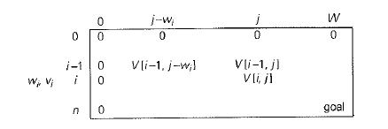
Table For Solving Knapsack Problem

Slide 39
Table For Solving Knapsack Problem
For i, j > 0, to compute the entry in the i^{th} row and the j^{th} column, V[i, j], we compute the maximum of the entry in the previous row and the same column and the sum of v_{i} and the entry in the previous row and w_{i} columns to the left.
The table can be filled either row by row or column by column.

Slide 40
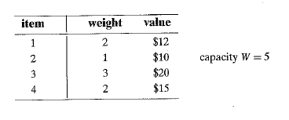
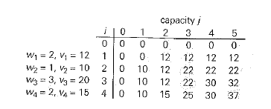
Knapsack Problem - Example

Slide 41
Knapsack Problem - Efficiency
The time efficiency and space efficiency are both Θ (nW).
The time needed to find the composition of an optimal solution is O(n + W).

Slide 42
Memory Functions
Dynamic Programming deals with problems which satisfy a recurrence relation with overlapping sub problems.
The top - down approach to solve such a recurrence leads to an algorithm that solves common sub problems more than once.
The dynamic programming approach (bottom – up) solves these sub problems only once.
But the disadvantage is that sometimes it solves sub problems which are not necessary for solving the problem for the given instance.
The goal is to build a method which solves only those sub problems which are necessary.

Slide 43
Memory Functions
This method solves a problem in the top – down manner but maintains a table similar to the one maintained by the bottom – up approach.
Initially, all the table's entries are initialized with a special "null" symbol to indicate that they have not yet been calculated. Thereafter, whenever a new value needs to be calculated, the method checks the corresponding entry in the table first:
if this entry is not "null," it is simply retrieved from the table;
otherwise, it is computed by the recursive call whose result is then recorded in the table.

Slide 44
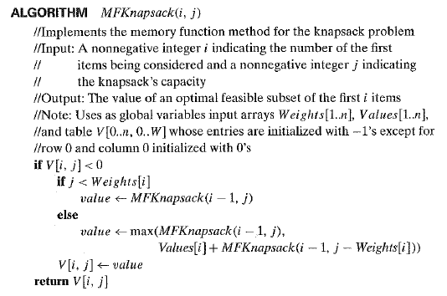
Memory Functions – The ALGORITHM

Slide 45
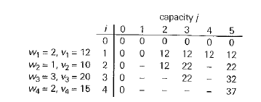
Memory Functions - EXAMPLE

Slide 46
Knapsack Problem with Memory Functions - Efficiency
Same as the efficiency of Bottom – Up algorithm except for a constant factor gain.

